Slide 1
Direct Vision-Based SLAM for Environments with Onboard Illumination
Ryan Slocum
Department of Computer Science
University of Colorado at Boulder
Advisor: Dr. Chris Heckman

Slide 2
1 Introduction | 2 Background | 3 Methods
4 Results | 5 Discussion | 6 Questions

Slide 3
1 Introduction | 2 Background | 3 Methods
4 Results | 5 Discussion | 6 Questions

Slide 4
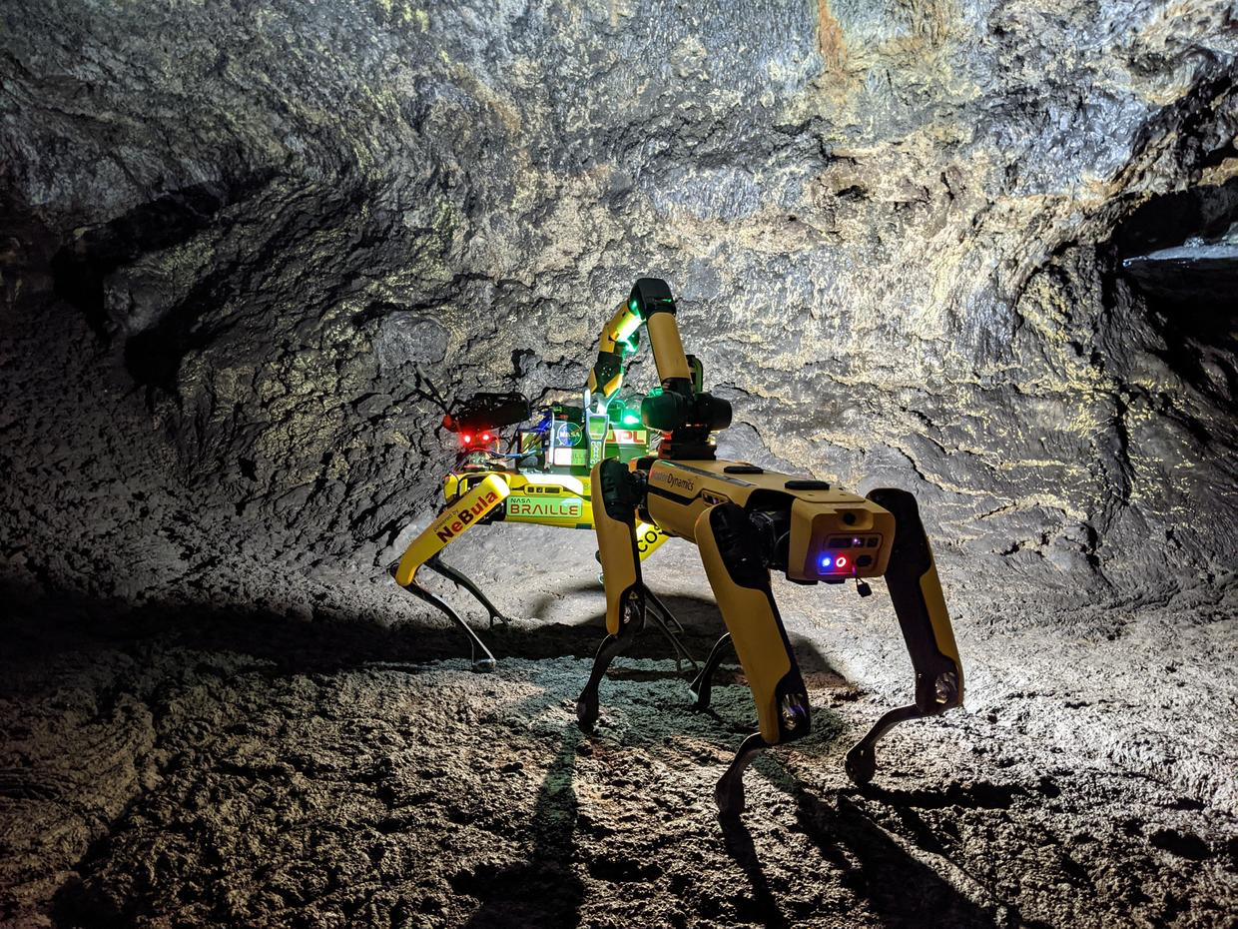
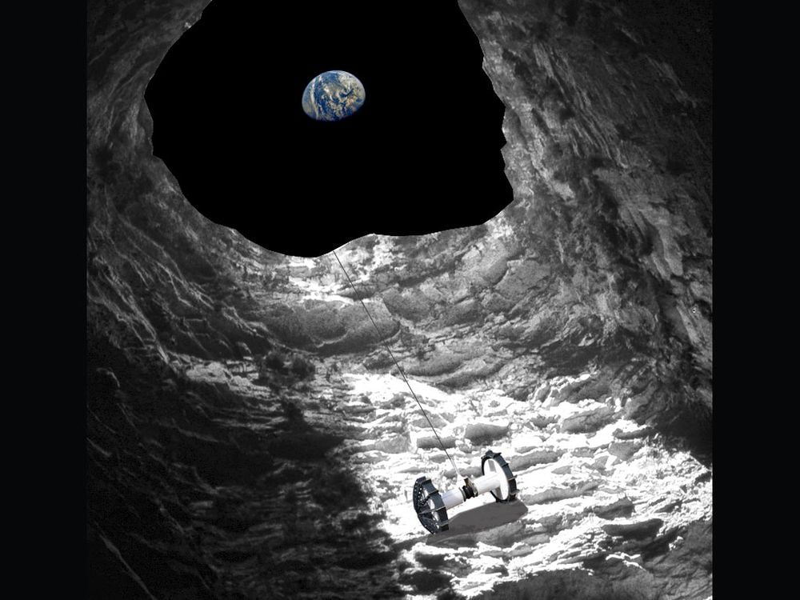
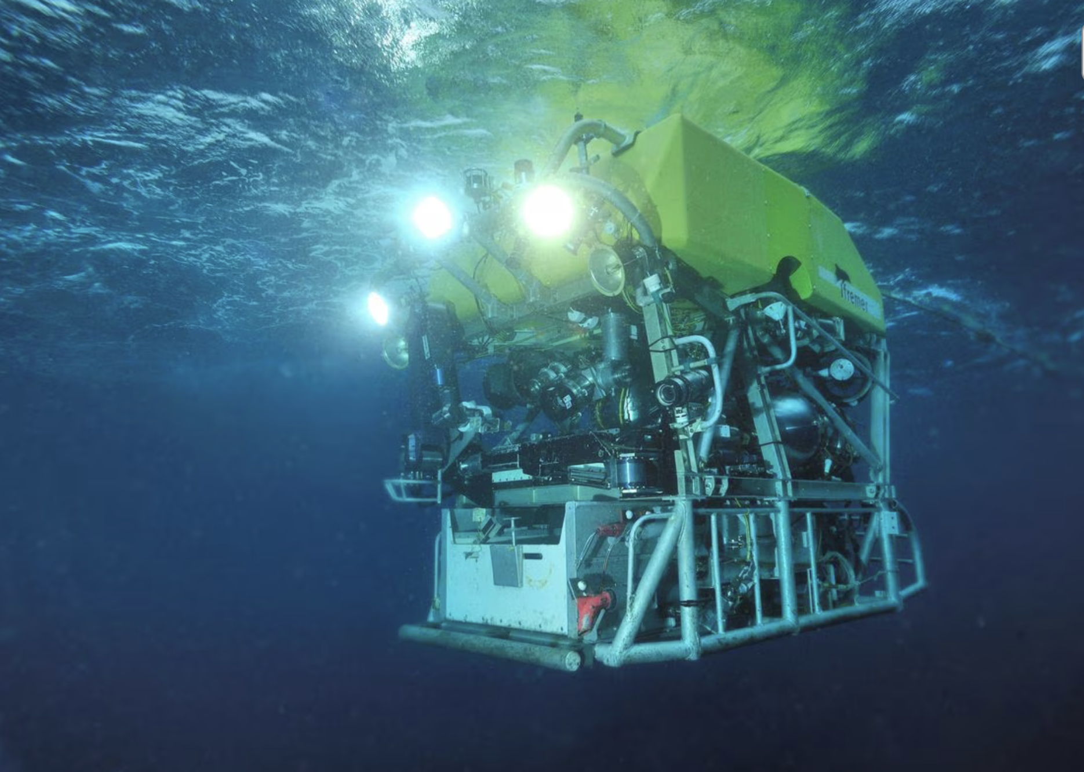
Introduction
Vision-based systems are simple, low-cost, and ubiquitous
Robots need to operate in low-light environments
Spot robots using onboard illumination
NASA/JPL, 2021
Onboard illumination is necessary for state estimation
Victor 6000 operating underwater
Reuters, 2023
Artist rendering of lunar cave exploring robot
NASA/JPL, 2019

Slide 5
1 Introduction | 2 Background | 3 Methods
4 Results | 5 Discussion | 6 Questions

Slide 6
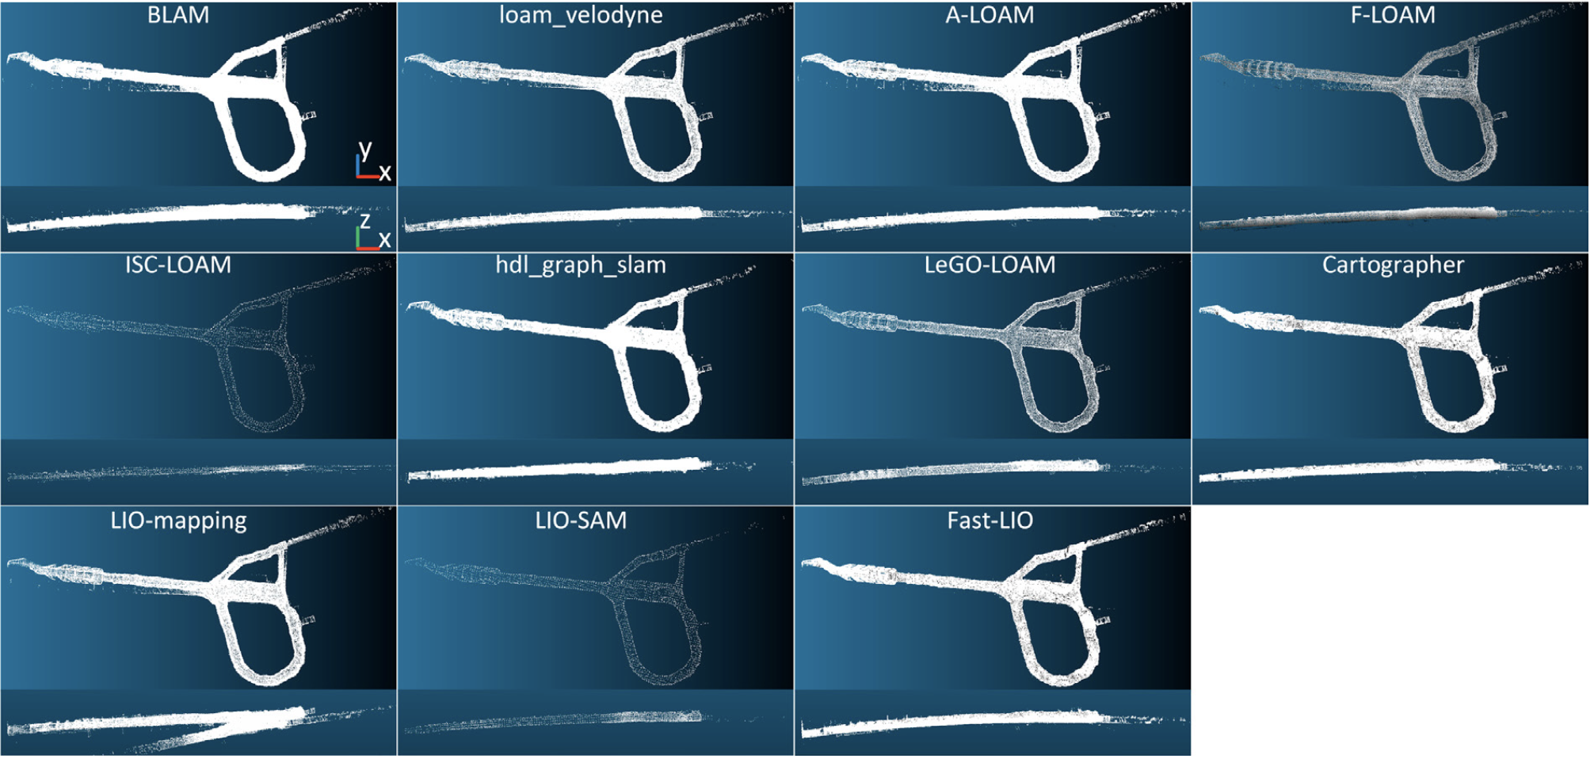
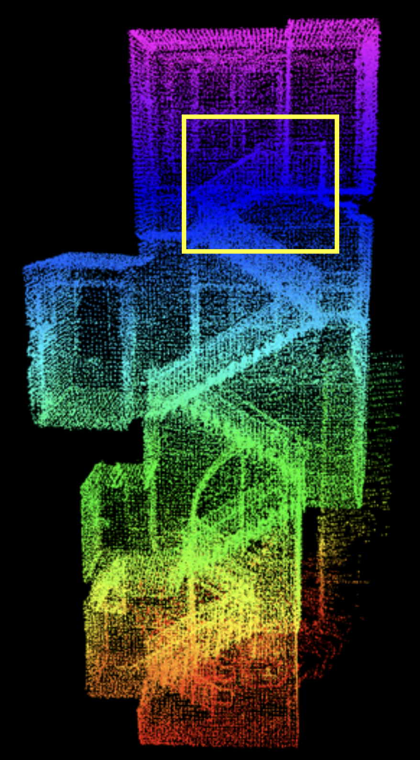
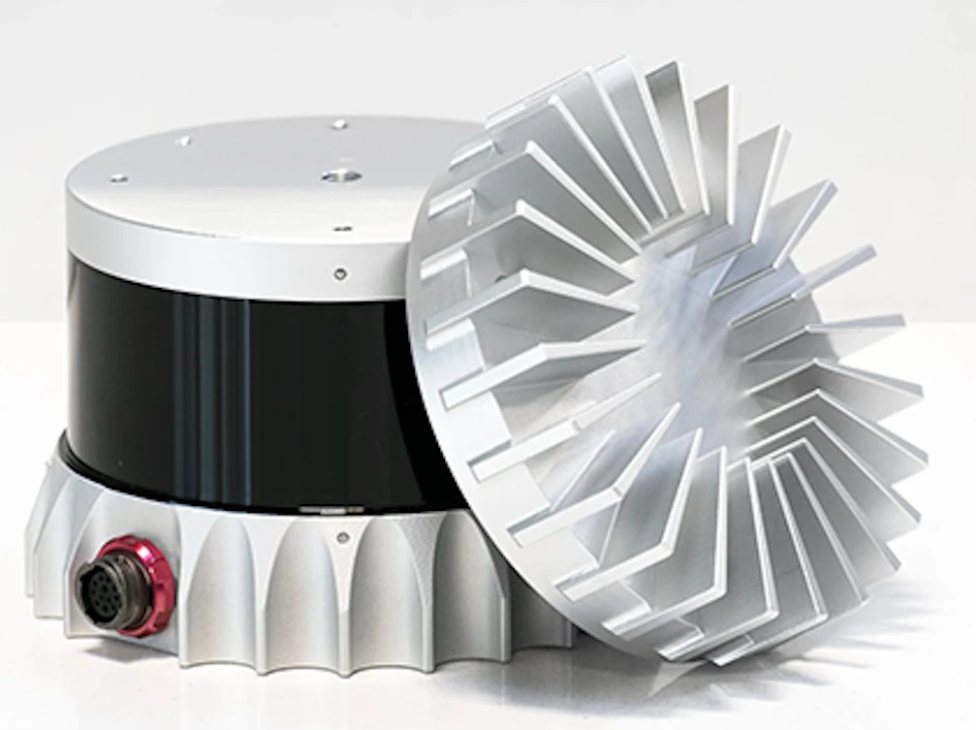
Simultaneous Localization and Mapping (SLAM)
Common for robotics applications
Critical for state estimation in unknown environments
Implementation with Lidar can be robust, but costly
Performance of lidar SLAM methods in SubT environment
Koval, Kanellakis, and Nikolakopoulos, 2022
LOAM point cloud on a challenging staircase
Zhang and Singh, 2014
Entry-level Lidar from Ouster: $8000
Pacala, 2019

Slide 7
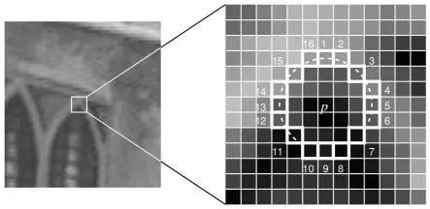
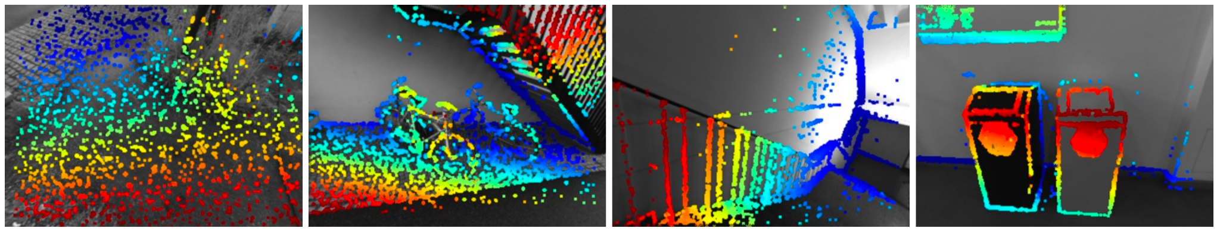
Visual SLAM (vSLAM)
vSLAM uses primarily visual data for localization and mapping
Two main types: Indirect and Direct
Indirect methods use keypoints, direct methods use pixel-to-pixel comparison
The FAST keypoint detector used by ORB in ORB-SLAM
Tyagi, 2019
Depth Maps from DSO
Engels, Kolton, and Cremers, 2016

Slide 8
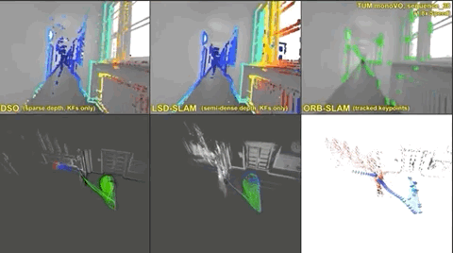
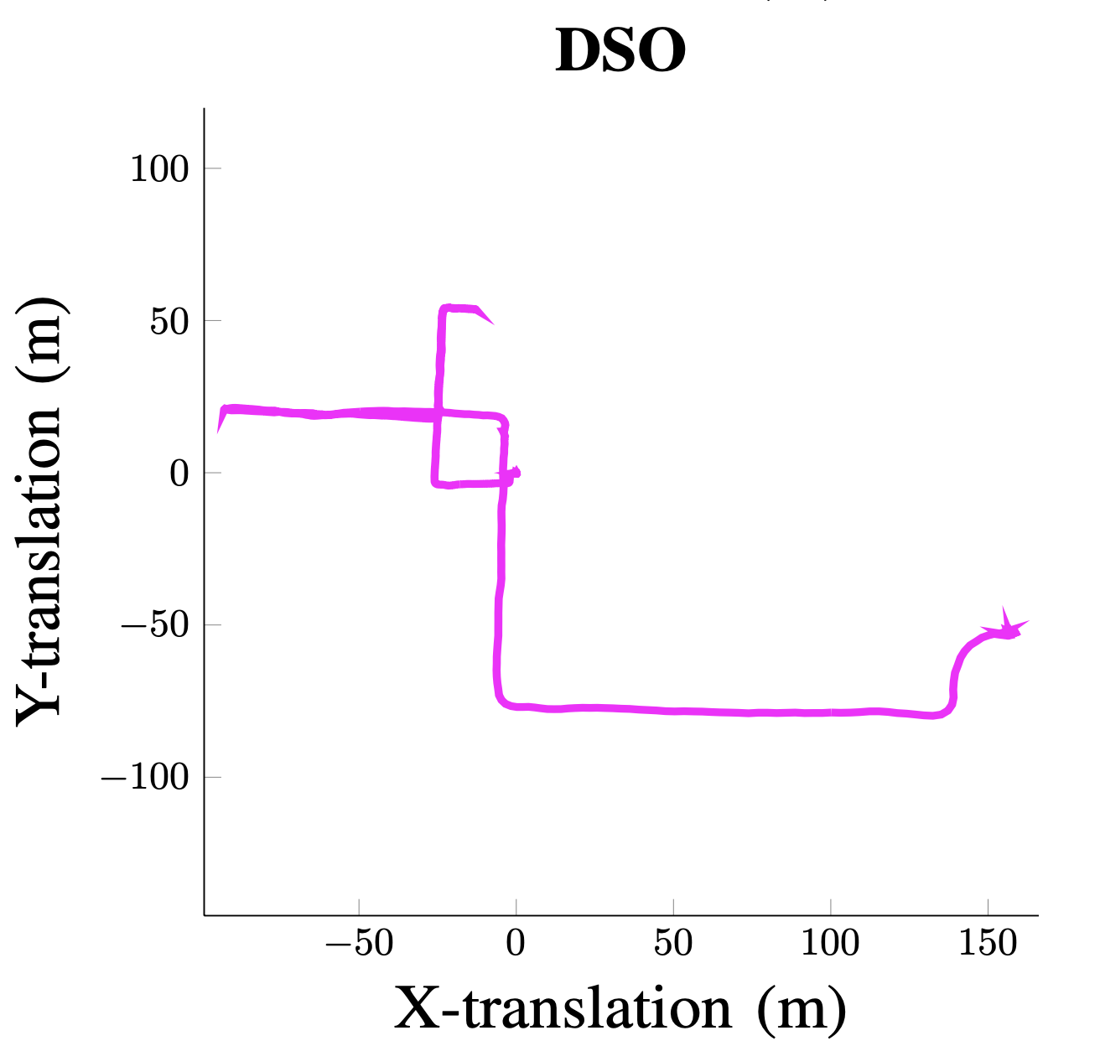
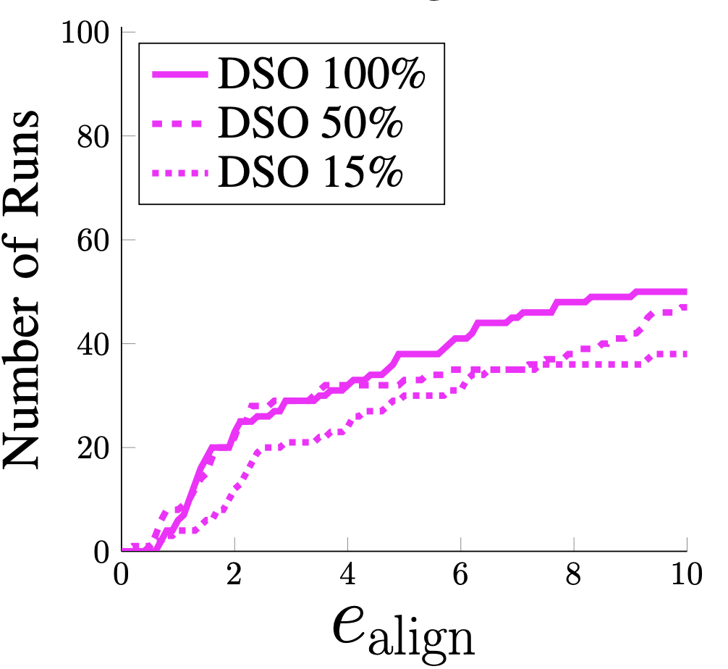
Direct vSLAM - Direct Sparse Odometry
Direct Sparse Odometry (DSO) - developed in 2016 by Jakob Engel
Uses direct pixel intensities, but sub-samples candidate points for a sparse map and performance
Improvement possible from illumination information
DSO compared with LSD-SLAM and ORB-SLAM
Engels, Kolton, and Cremers, 2016
DSO performance across OIVIO dataset
Kasper, McGuire, and Heckman, 2019

Slide 9
Background Summary
Robots need to navigate low-light environments
Cameras are cheaper and more ubiquitous than Lidar
Direct methods have a lighting-constancy assumption
Direct methods currently perform poorly in these environments, but there is room for improvement

Slide 10
1 Introduction | 2 Background | 3 Methods
4 Results | 5 Discussion | 6 Questions

Slide 11
Methods
Goal:
Integrate lighting information into Direct Sparse Odometry
Illumination Modeling | Modify Pixel Residual | Full-System Optimization | Evaluate vs Original DSO

Slide 12
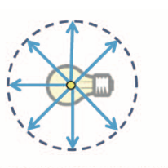
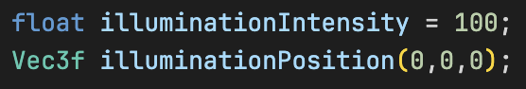
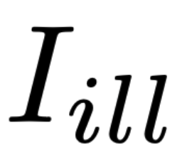
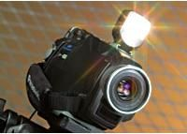
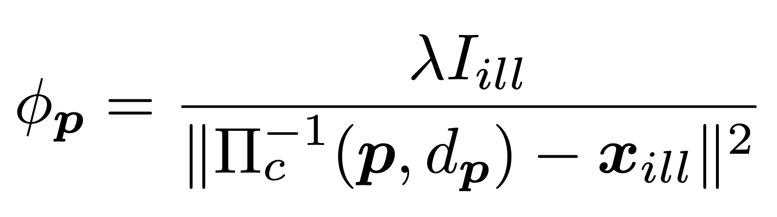

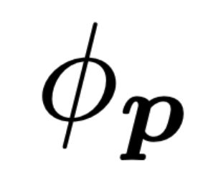
Light Modeling
Step 1: Model onboard illumination source
Point light source is sufficient for our purposes
Requires two parameters:
Point Light Model with uniform radiation
Takahito Aoto et al, 2013
Light reflected to camera from point p
Videomaker, 2024

Slide 13
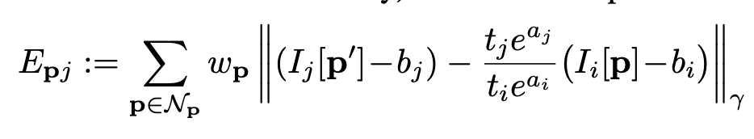
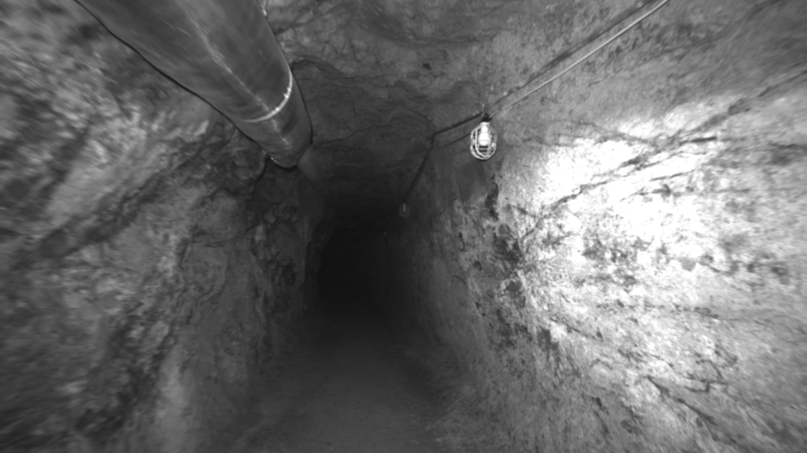
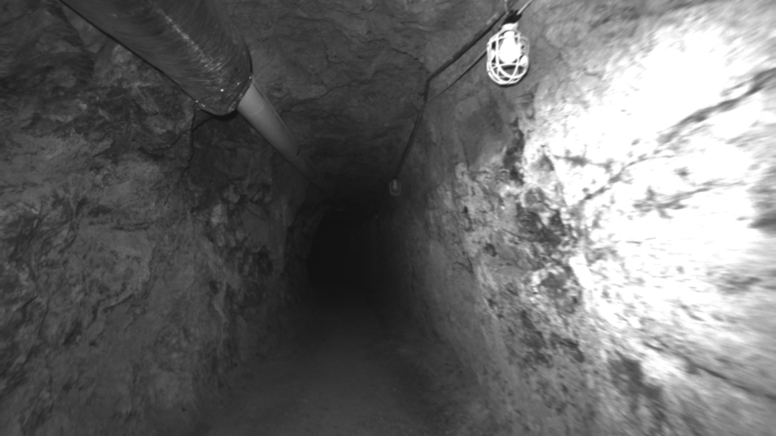
Energy Residual
Step 2: Modify pixel energy residual
Original DSO residual compares the intensity of a point in two different images
Original pixel energy calculation
Engels, Kolton, and Cremers, 2016
Target Frame
Source Frame
Source Frame
Target Frame

Slide 14
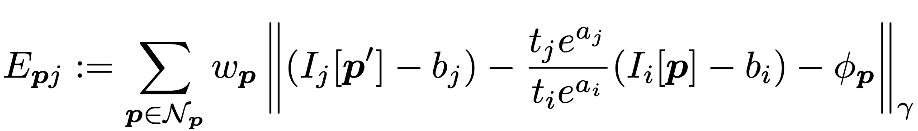
Energy Residual
Step 2: Modify pixel energy residual
Original DSO residual compares the intensity of a point in two different images
Modified residual incorporates reflected light intensity

Slide 15
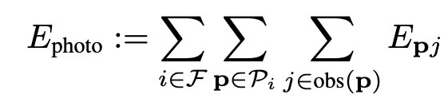
Optimization
Step 3: Full-system optimization to minimize energy
Energy residuals are summed across candidate points and keyframes for a total “error”
DSO uses Gauss-Newton optimization to minimize this error
Total residual calculation
Engels, Kolton, and Cremers, 2016

Slide 16
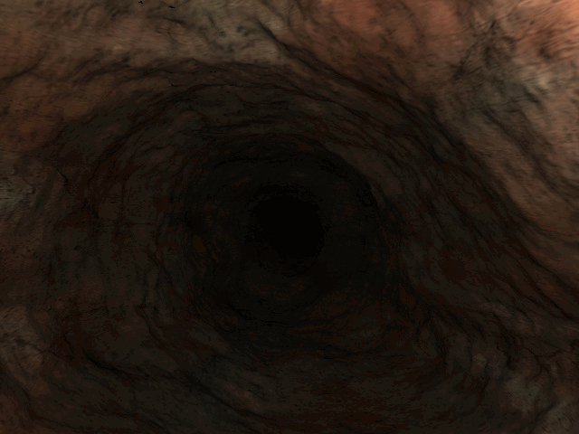
Evaluation
Used synthetic cave data from Spelunk simulation, developed by Mike Kasper
Generated eight different trajectories, each with different types of motion
Compared Relative Pose Error (RPE) and Absolute Trajectory Error (ATE) between original DSO and modified version
Spelunk Simulation Run

Slide 17
1 Introduction | 2 Background | 3 Methods
4 Results | 5 Discussion | 6 Questions

Slide 18
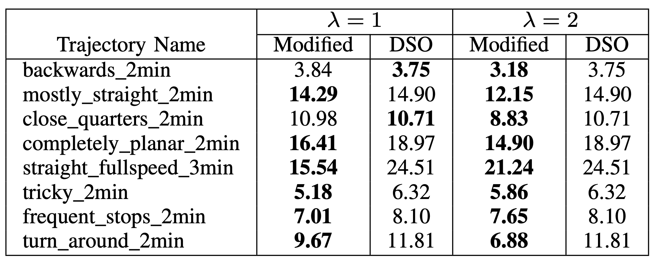
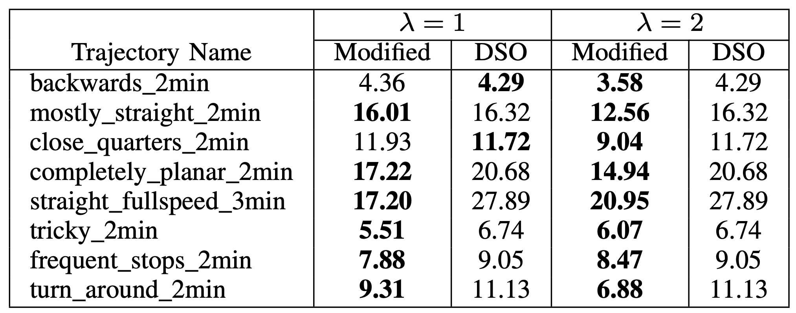
Results - Overall
Absolute Trajectory Error
Relative Pose Error
Averages across 5 runs

Slide 19
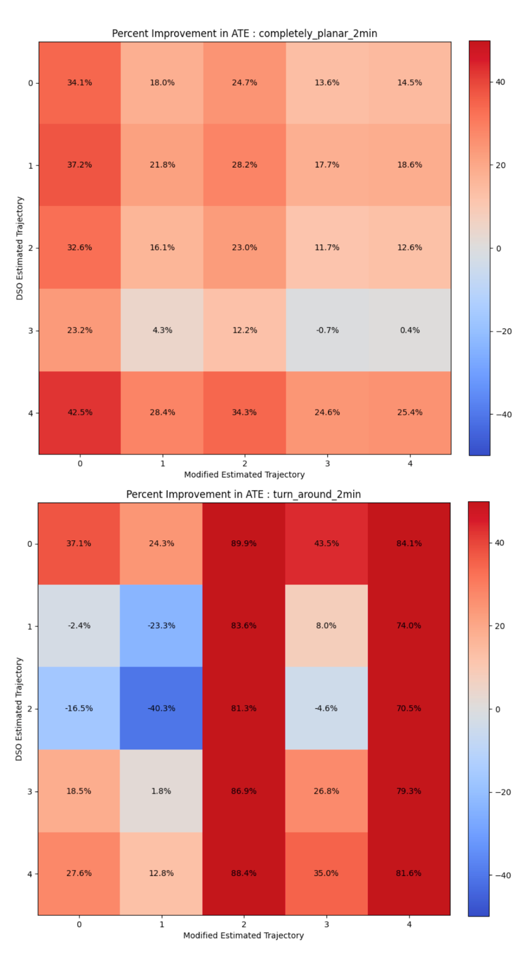
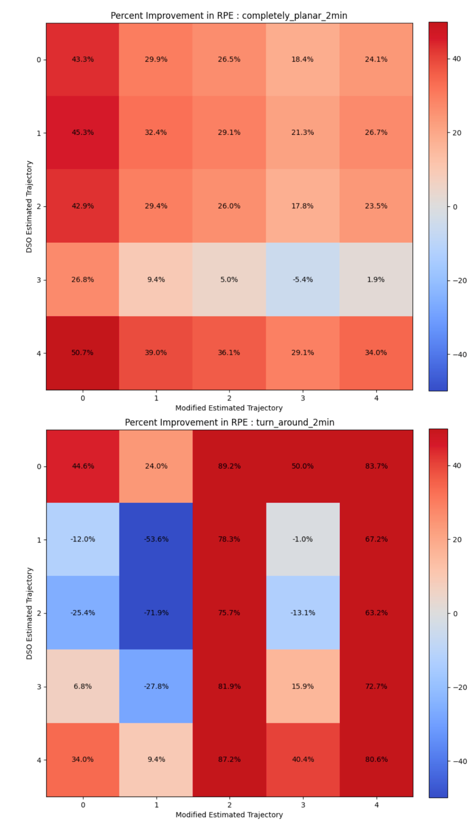
Results - Percent Improvement
Absolute Trajectory Error
Relative Pose Error

Slide 20
Results - Percent Improvement
Absolute Trajectory Error
Relative Pose Error

Slide 21
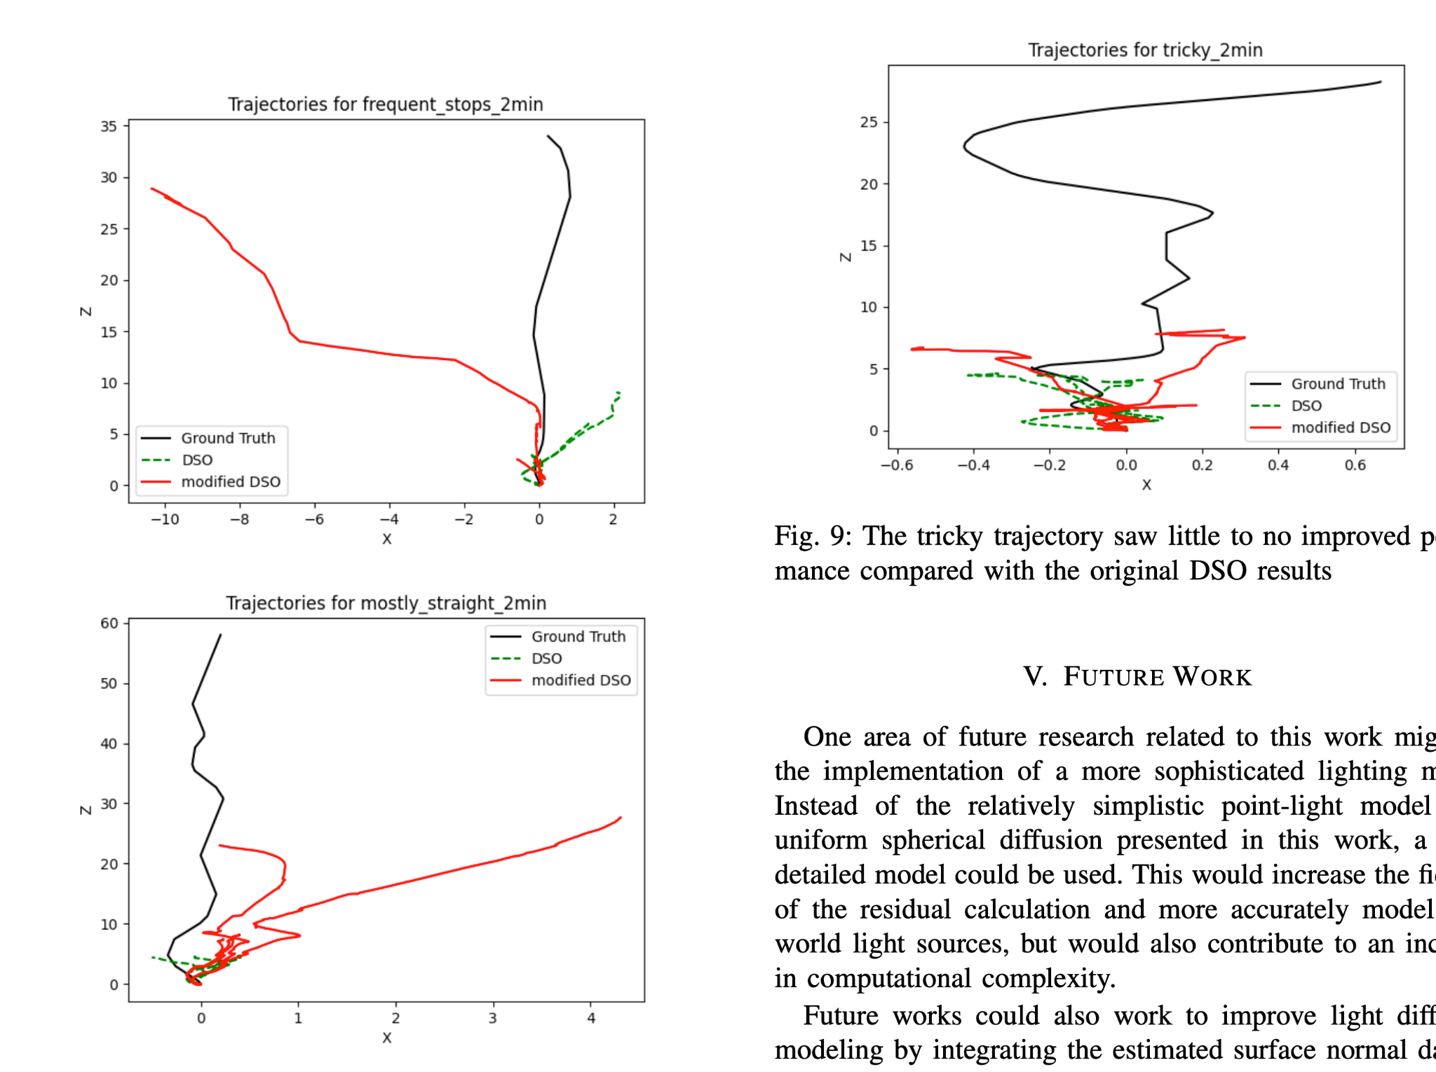
Tracking Improvement
Major improvements in translational tracking, but persistent issues with rotational
Difficult trajectories saw little improvement

Slide 22
1 Introduction | 2 Background | 3 Methods
4 Results | 5 Discussion | 6 Questions

Slide 23
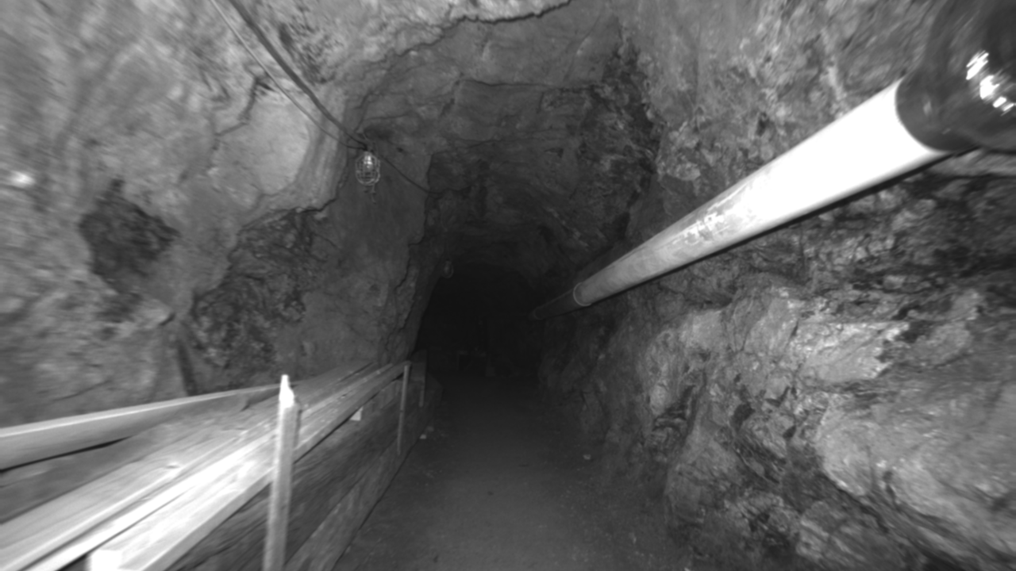
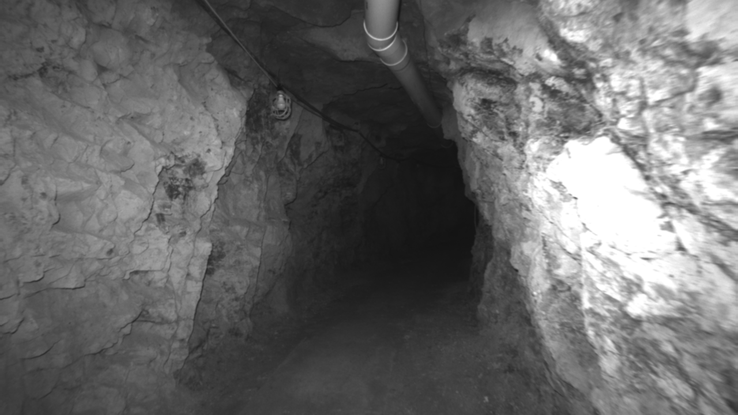
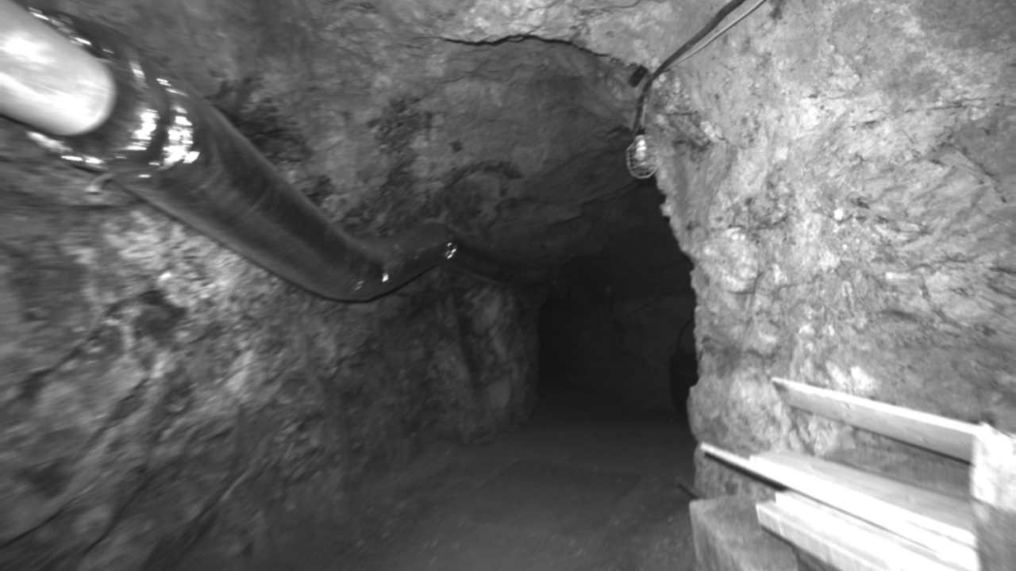
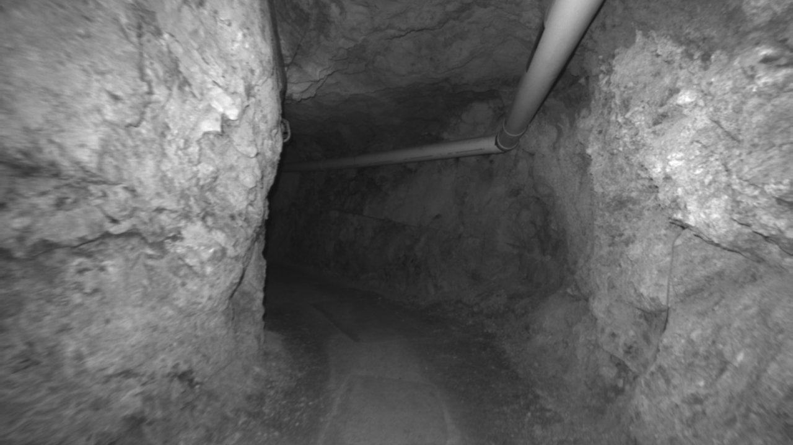
Discussion
Overall, this method shows promise for increased tracking performance
However, a large amount of the gains were due to the initially terrible performance of DSO
The presented method serves as a proof-of-concept
Not yet suitable for real-world use, but next steps include testing on datasets like OIVIO
Kasper, McGuire, and Heckman, 2019

Slide 24
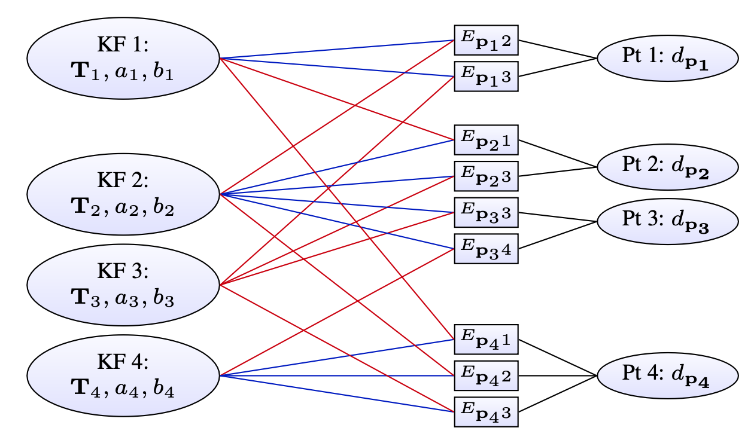
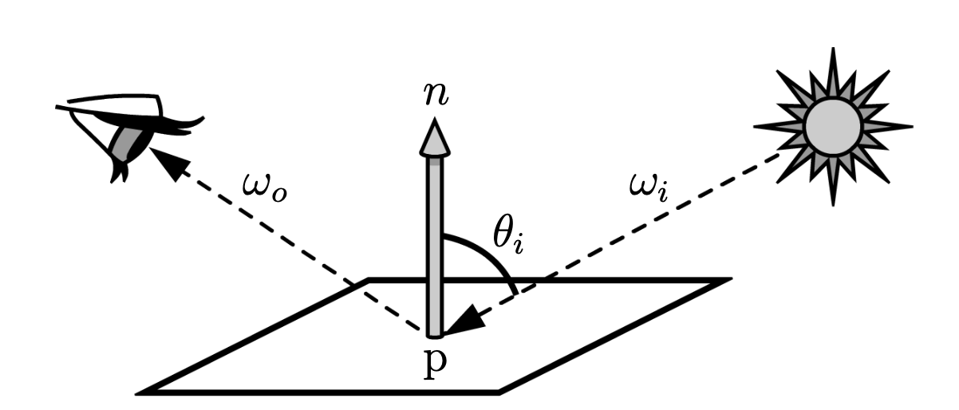
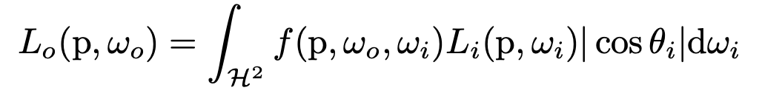
Future Areas of Research
Engels, Kolton, and Cremers, 2016
Better illumination modeling:
Use computer graphics techniques and surface normal data for more accurate illumination information
Joint optimization for light parameters:
The modified system solves for illumination intensity and position in addition to camera pose and surface geometry
Kasper et. al., 2017

Slide 25
1 Introduction | 2 Background | 3 Methods
4 Results | 5 Discussion | 6 Questions

Slide 26
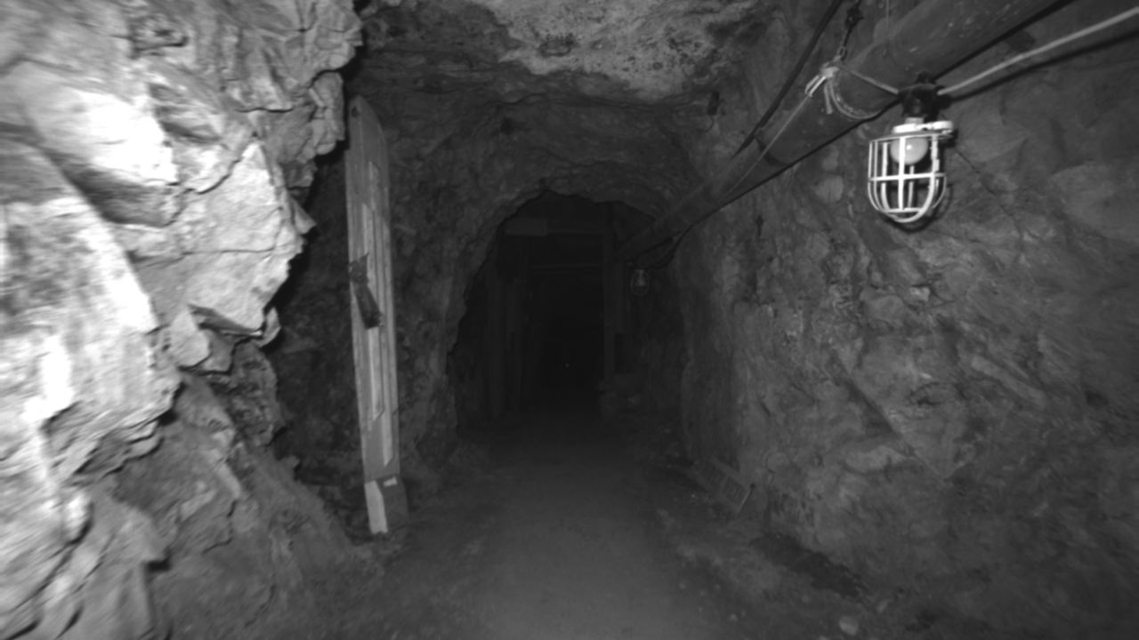
Questions

Slide 27
References
Jakob Engel, Vladlen Koltun, and Daniel Cremers. “Direct Sparse Odometry”. In: IEEE Transactions on Pattern Analysis and Machine Intelligence PP (July 2016). DOI: 10.1109/TPAMI.2017.2658577.
Michal Irani and P. Anandan. “All About Direct Methods”. In: 1999. URL: https://api.semanticscholar.org/ CorpusID:7315270.
Mike Kasper, Steve McGuire, and Christoffer Heckman. “A Benchmark for Visual-Inertial Odometry Systems Employing Onboard Illumination”. In: Intelligent Robots and Systems (IROS). 2019.
Mike Kasper et al. Light Source Estimation with Analytical Path-tracing. 2017. arXiv: 1701.04101 [cs.CV].
Anton Koval, Christoforos Kanellakis, and George Nikolakopoulos. “Evaluation of Lidar-based 3D SLAM algorithms in SubT environment”. In: IFACPapersOnLine 55.38 (2022). 13th IFAC Symposium on Robot Control SYROCO 2022, pp. 126–131. ISSN: 2405-8963. DOI: https://doi.org/10.1016/j.ifacol.2023. 01.144. URL: https://www.sciencedirect.com/science/article/pii/S2405896323001519.
Raul Mur-Artal and Juan D. Tardos. “ORB-SLAM2: An Open-Source SLAM System for Monocular, Stereo, and RGB-D Cameras”. In: IEEE Transactions on Robotics 33.5 (Oct. 2017), pp. 1255–1262. DOI: 10 . 1109 / tro . 2017.2705103. URL: https://doi.org/10.1109%2Ftro. 2017.2705103.
Lukas von Stumberg, Vladyslav Usenko, and Daniel Cremers. “Direct Sparse Visual-Inertial Odometry using Dynamic Marginalization”. In: CoRR abs/1804.05625 (2018). arXiv: 1804.05625. URL: http://arxiv.org/abs/ 1804.05625.

